Slide 1
Journey through a CS program
Group name: SYSERROR
Group members: Hamza Bachnak, Alex Lee, Yusri Zafri,

Slide 2
Table of contents
Background
Resources
Higher level Requirements
Gantt Chart
GUI
Conclusion

Slide 3
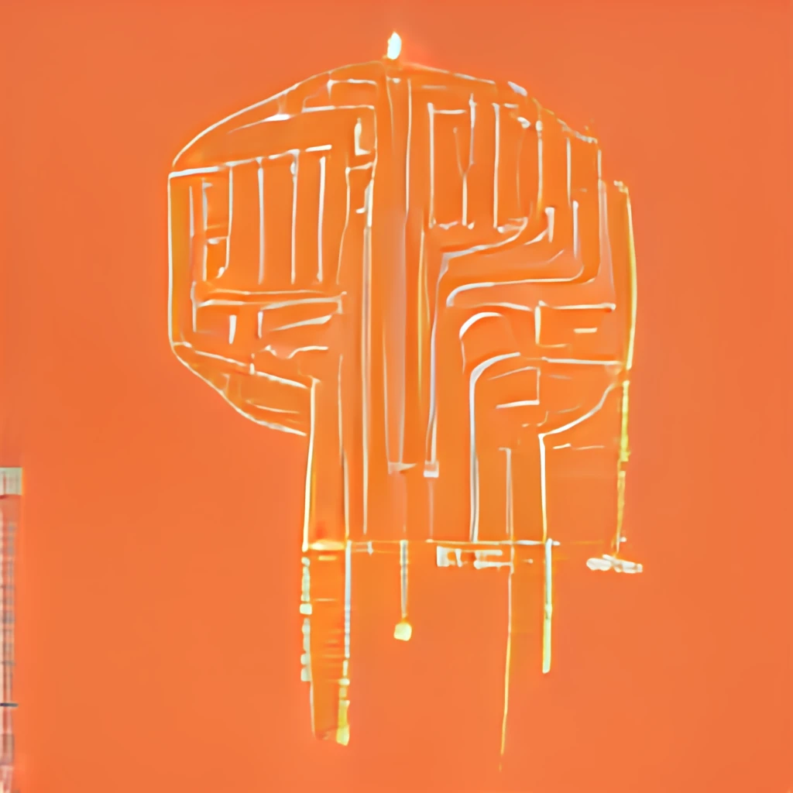
Background
Reason for project:
Self-insert project
Teaching CS
Sharing experiences

Slide 4
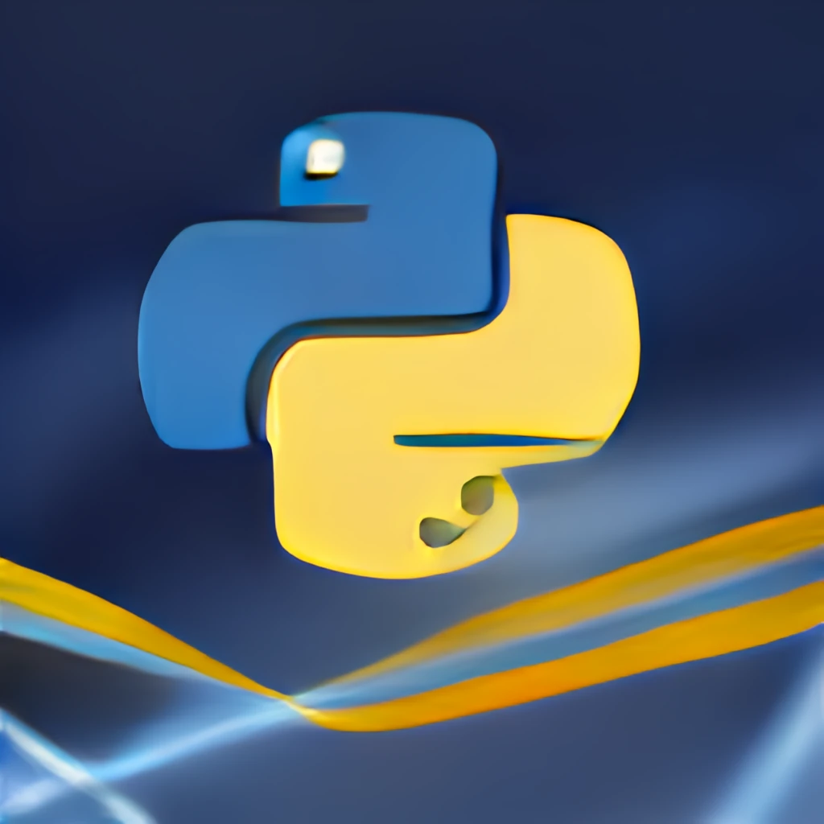
Resources
Ren’Py library
OPEN AI Technology
Python programming language

Slide 5
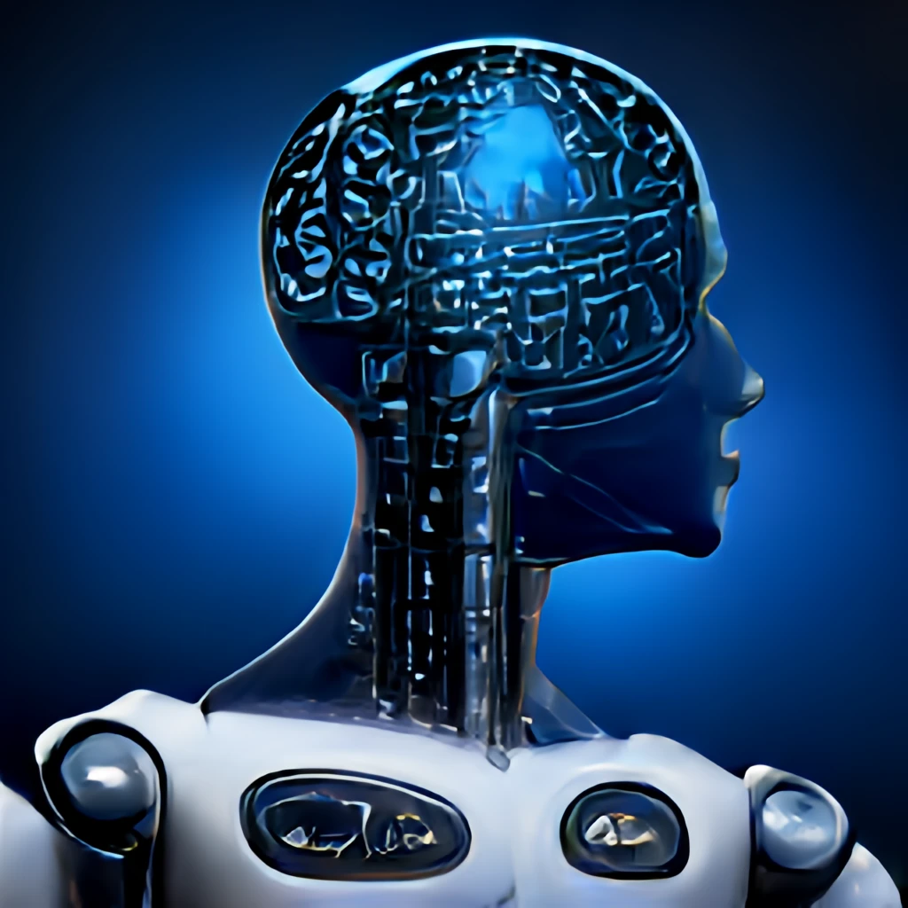
Goals
Investigating the viability of AI generated assets in game development
Application of learned skills in an interactive project
Pushing boundaries of AI capability in an “applied” scenario, game development.

Slide 6
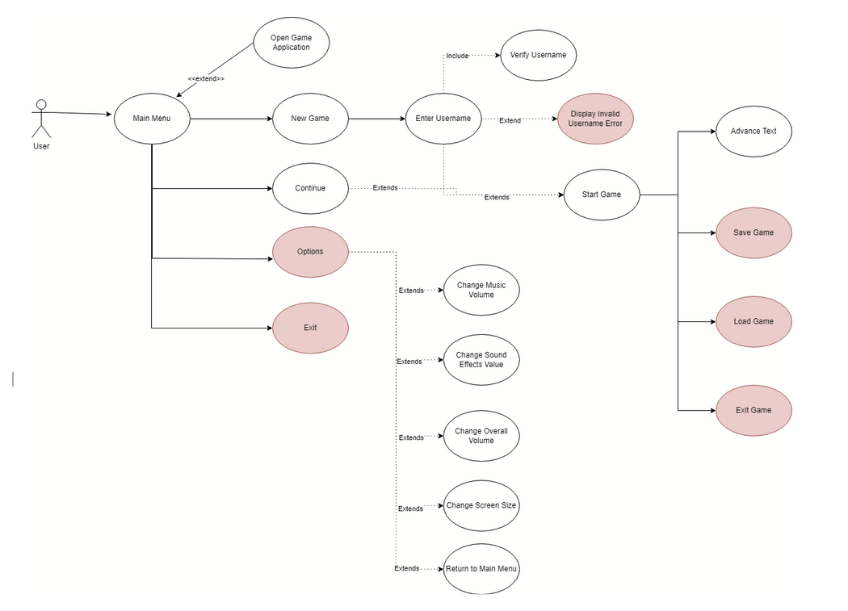

Slide 7
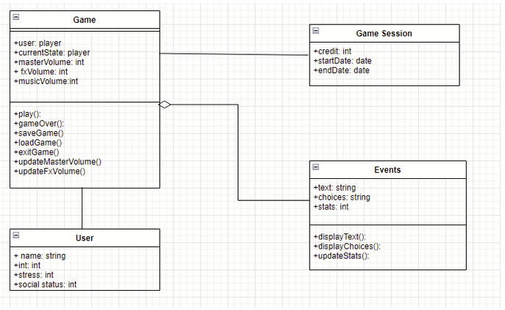

Slide 8
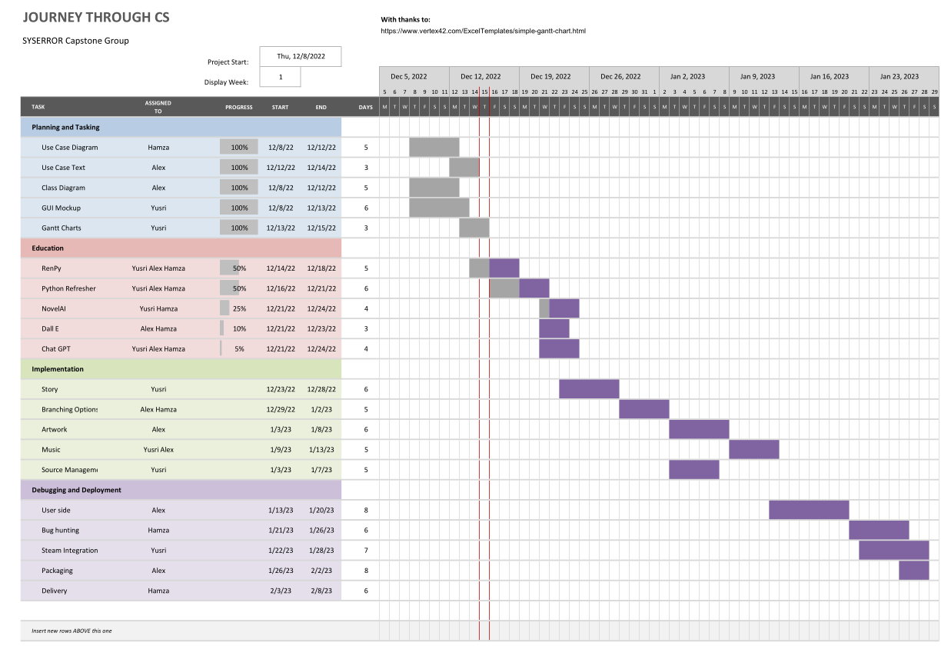

Slide 9
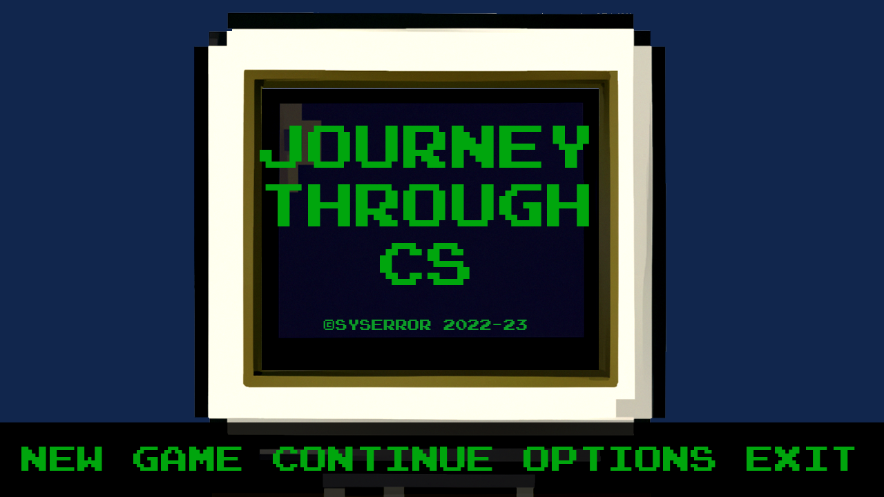
GUI

Slide 10
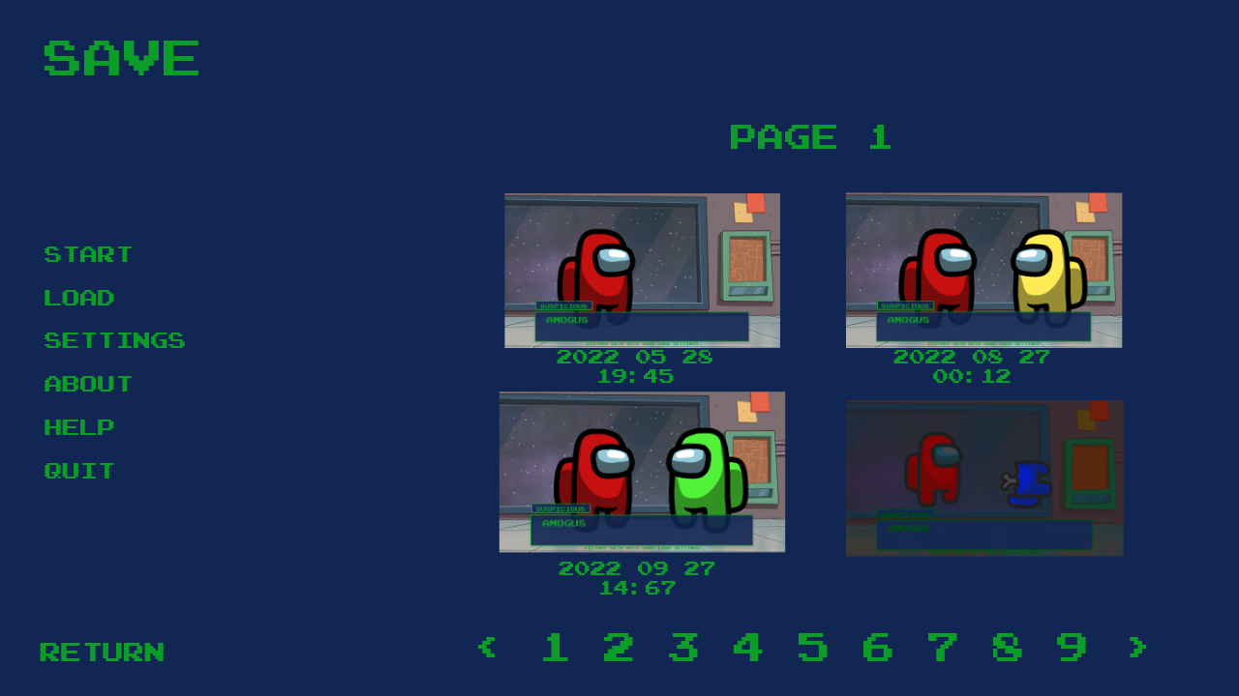
New game/Load game

Slide 11
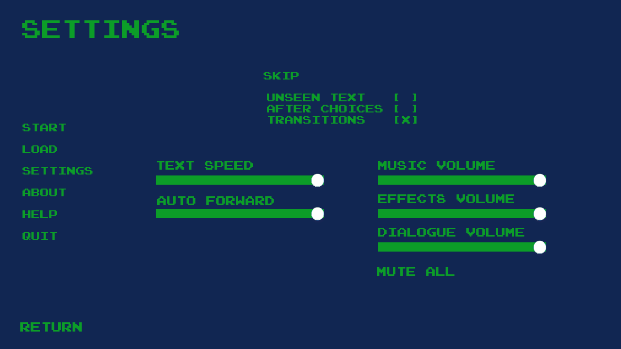
Settings

Slide 12
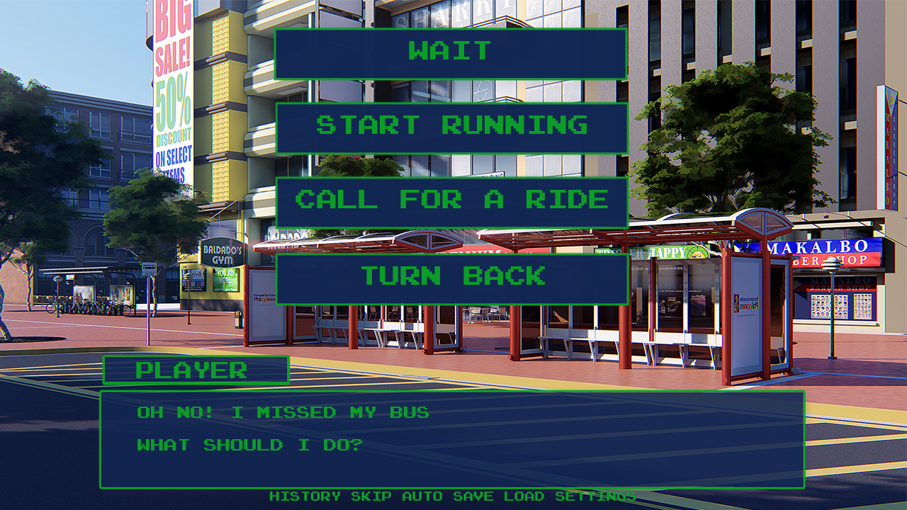

Slide 13
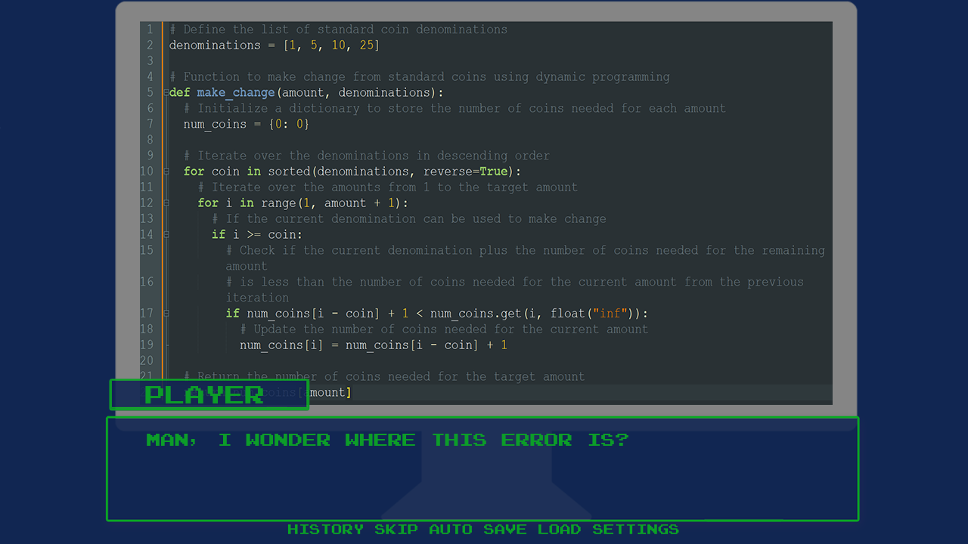

Slide 14
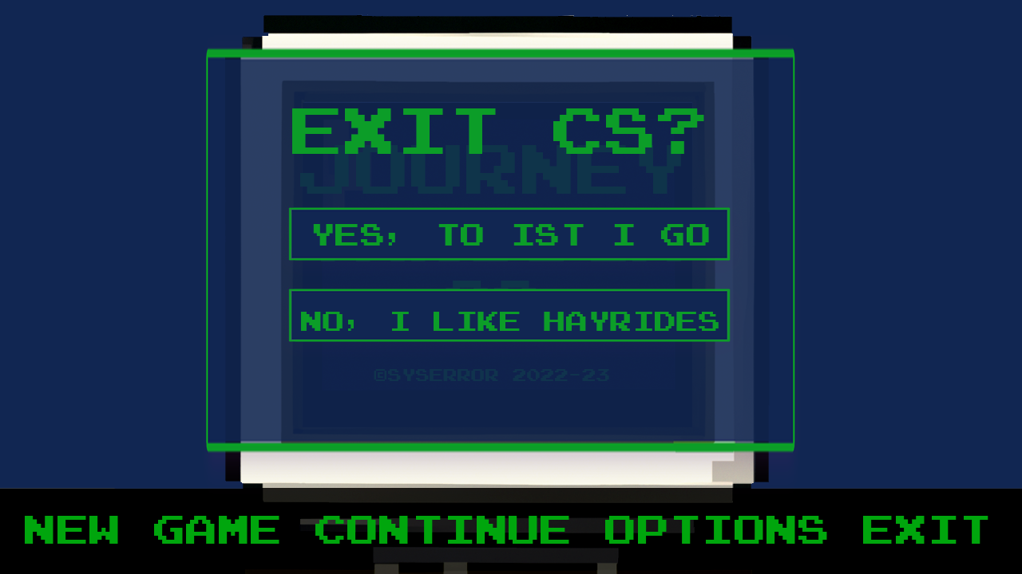
Exit game

Slide 15
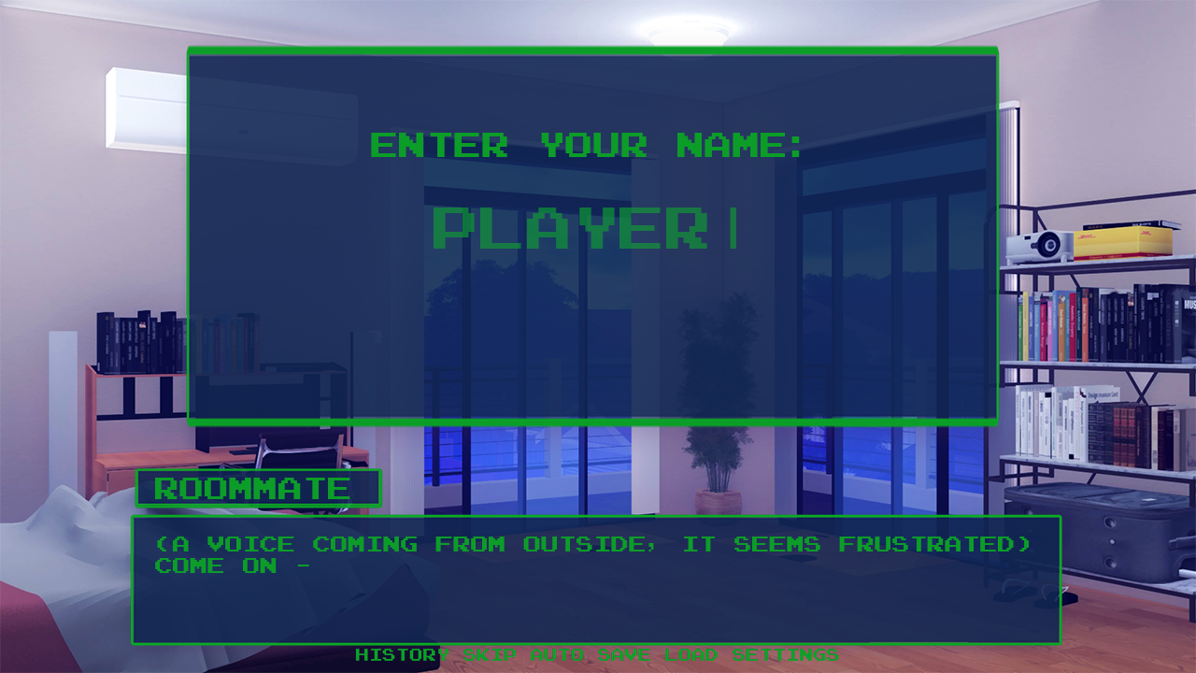

Slide 16
Further Developments
Ren’Py/python
Using AI to generate assets
Prologue
Minigames
Find the semicolon
CS Trivia
Multiple Endings

